Slide 1


Becoming a Pro IN Mobile Applications Testing

Slide 2
Overview: Mobile APPS
Types
Categories
Troubleshooting Guide
Simulators
Emulators
Remote Device Access (RDA)
Mobile Test Industry Standards
Distribution/Installation/Logs
App Risk Analysis

Slide 3
MOBILE APPS: Categories
Utilities
Entertainment
Games
News
Productivity
Lifestyle
Social Networking

Slide 4
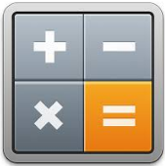



MOBILE APPS: Utilities
Calculators
Note-pads
Communi-cation. apps
Weather apps

Slide 5




MOBILE APPS: Entertainment
Face Juggler
Ice Effex
Duolingo
DubSmash

Slide 6




MOBILE APPS: Games
Angry Birds
Sudoku
Trivia Crack
Candy Crash Saga

Slide 7




MOBILE APPS: NEWS
The NYT app
Buzzfeed
Flipboard
Reddit

Slide 8




MOBILE APPS: Productivity
Finance apps
Calendars
Translators
Grocery list makers

Slide 9




MOBILE APPS: Lifestyle
Music apps
Travel Apps
Food & Drink apps
Dating apps

Slide 10




MOBILE APPS: Social Networking
Facebook
Circles
Path
Instagram

Slide 11
Overview: Mobile APPS
Types
Categories
Troubleshooting Guide
Simulators
Emulators
Remote Device Access (RDA)
Mobile Test Industry Standards
Distribution/Installation/Logs
App Risk Analysis

Slide 12

MOBILE APPS: Types
Tree basic types of "app“
Native
Web
Hybrid
Built specifically to the needs of the various operating systems such as Apple's iOS or Android
Websites built using HTML that are designed specifically for smaller screens
Native app shell with feeds from the website

Slide 13

MOBILE APPS: Native APP
Written using the default language for the mobile platform, which is Objective C or Swift for iOS and Java for Android.
Compiled and executed directly on the device.
Using the platform SDK (API), the app can communicate with the platform to access device data or load data from an external website using http requests.

Slide 14
MOBILE APPS: Native APP
PROS
CONS
Native APIs
Performance
Same environment
Language requirements
Not cross platform
High level of effort

Slide 15

MOBILE APPS: WEB APP
Mobile websites are applications that work well on a mobile device, but are accessed through the mobile browser.
These websites viewed on a mobile device in a mobile browser, with the exception of being designed to fit a mobile device screen size.
Responsive web design can be used to make a web application - whether a conventional web site or a single-page application viewable on small screens and work well with touchscreens.

Slide 16
MOBILE APPS: WEB APP
PROS
CONS
Maintainability
No installation.
Cross platform.
No native access
Requires keyboard to load
Limited user interface.

Slide 17

MOBILE APPS: HYBRID APP
A hybrid app is one that combines elements of both native and Web applications
Hybrid apps are often mentioned in the context of mobile computing
For the most part, hybrid apps provide the best of both worlds

Slide 18
MOBILE APPS: HYBRID APP
PROS
CONS
Cross platform
Same skills as web development
Access to device
Ease of development
Web view limitations
Native via plugins
No native user interface controls
Experienced developers

Slide 19
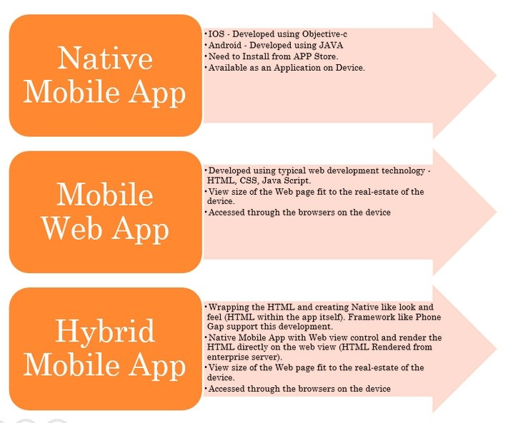
MOBILE APPS: SUMMARY

Slide 20
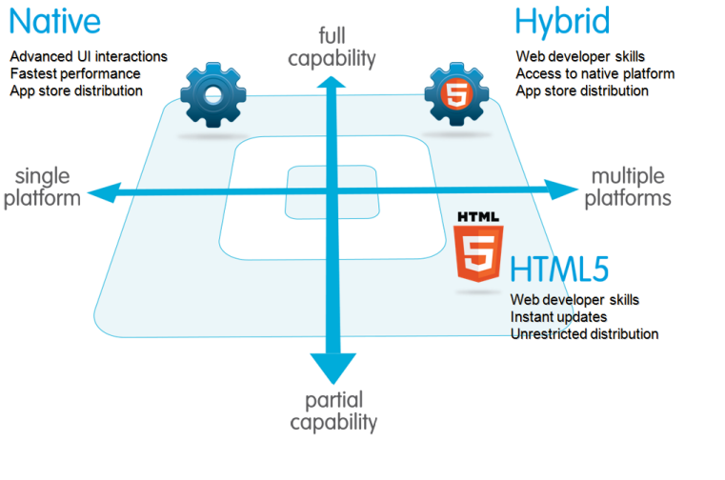
MOBILE APP types COMPARISSON

Slide 21

Mobile APPS : Conclusion
LIST | Native | HTML5 | Hybrid
App Features
Graphics | Native APIs | HTML, Canvas, SVG | HTML, Canvas, SVG
Performance | Fast | Slow | Slow
Native look and feel | Native | Emulated | Emulated
Distribution | Appstore | Web | Appstore
Device Access
Camera | Yes | No | Yes
Notifications | Yes | No | Yes
Contacts, calendar | Yes | No | Yes
Offline storage | Secure file storage | Shared SQL | Secure file system, shared SQL
Geolocation | Yes | Yes | Yes
Gestures
Swipe | Yes | Yes | Yes
Pinch, spread | Yes | No | Yes
Connectivity | Online and offline | Mostly online | Online and offline
Gestures
Swipe | Yes | Yes | Yes
Pinch, spread | Yes | No | Yes
Connectivity | Online and offline | Mostly online | Online and offline

